Slide 1
2026 Molecular Epidemiology Training Series Module 1: Foundations of Genomic Epidemiology
Practical: CRAB Outbreak Analysis
Georgia Public Health Laboratory / Tatyana Kiryutina, Bioinformatics Manager / Sept. 4, 2026

Slide 2
Learning Objectives
Understand the bioinformatics-to-epidemiology workflow for bacterial outbreak analysis.
Outline data sharing and collaboration between public health bioinformaticians and epidemiologists.
Generate a phylogenetic tree, pairwise genomic distance matrix, and other visualizations in Microreact.
Interpret phylogenetic clusters in the context of an outbreak.

Slide 3
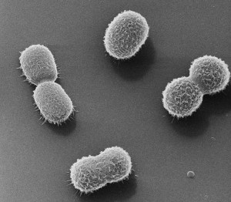
CP-CRAB Outbreak Scenario
In November 2024, the Georgia Department of Public Health (DPH) identified a multi-facility CP-CRAB outbreak in central Georgia.
Carbapenemase-producing carbapenem-resistant Acinetobacter baumannii (CP-CRAB) is a healthcare-associated pathogen that can persist in healthcare environments and spread among vulnerable patients.
Healthcare-associated infections (HAIs) are infections acquired while receiving healthcare. Those caused by antimicrobial-resistant (AMR) organisms can be difficult to treat and life-threatening.
Acinetobacter baumannii – helium ion microscopy
https://miphidic.com/2014/10/05/acinetobacter-baumannii-image/

Slide 4
Computational Environment Adaptability
The University of Florida supercomputing cluster, HiPerGator, is provided through our Bioinformatics Regional Resource (Florida BRR) to public health departments in the Southeast region.
The bioinformatics analysis code provided is configured for HiPerGator and its SLURM workload manager.
The workflow and associated scripts can be adapted for use in other computing environments.

Slide 5

Bioinformatics Workflow
Sequenced isolates on NCBI
srr_ids.txt
SRA Toolkit:
fasterq-dump
PHoeNIx
BigBacter
FASTQ
files
Genome
assemblies
(FASTA)
Microreact
file
srr_ids.txt
Additional isolates sequenced
Run instructions are laid out in DPH-Code-Running-Instructions.pptx
SRA Toolkit: https://github.com/ncbi/sra-tools/
PHoeNIx: https://github.com/CDCgov/phoenix/wiki
BigBacter: https://github.com/NW-PaGe/bigbacter

Slide 6
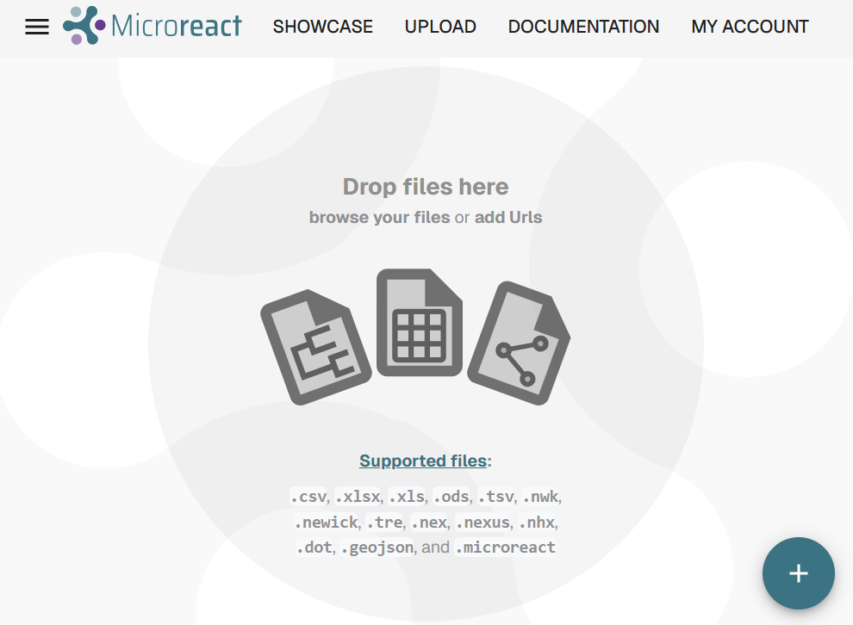
Main Output: Snippy Microreact File
The primary BigBacter output is the Microreact file (*.snippy.microreact)
Contains phylogenetic results needed for visualization and interpretation.
Will be uploaded directly to Microreact:

Slide 7
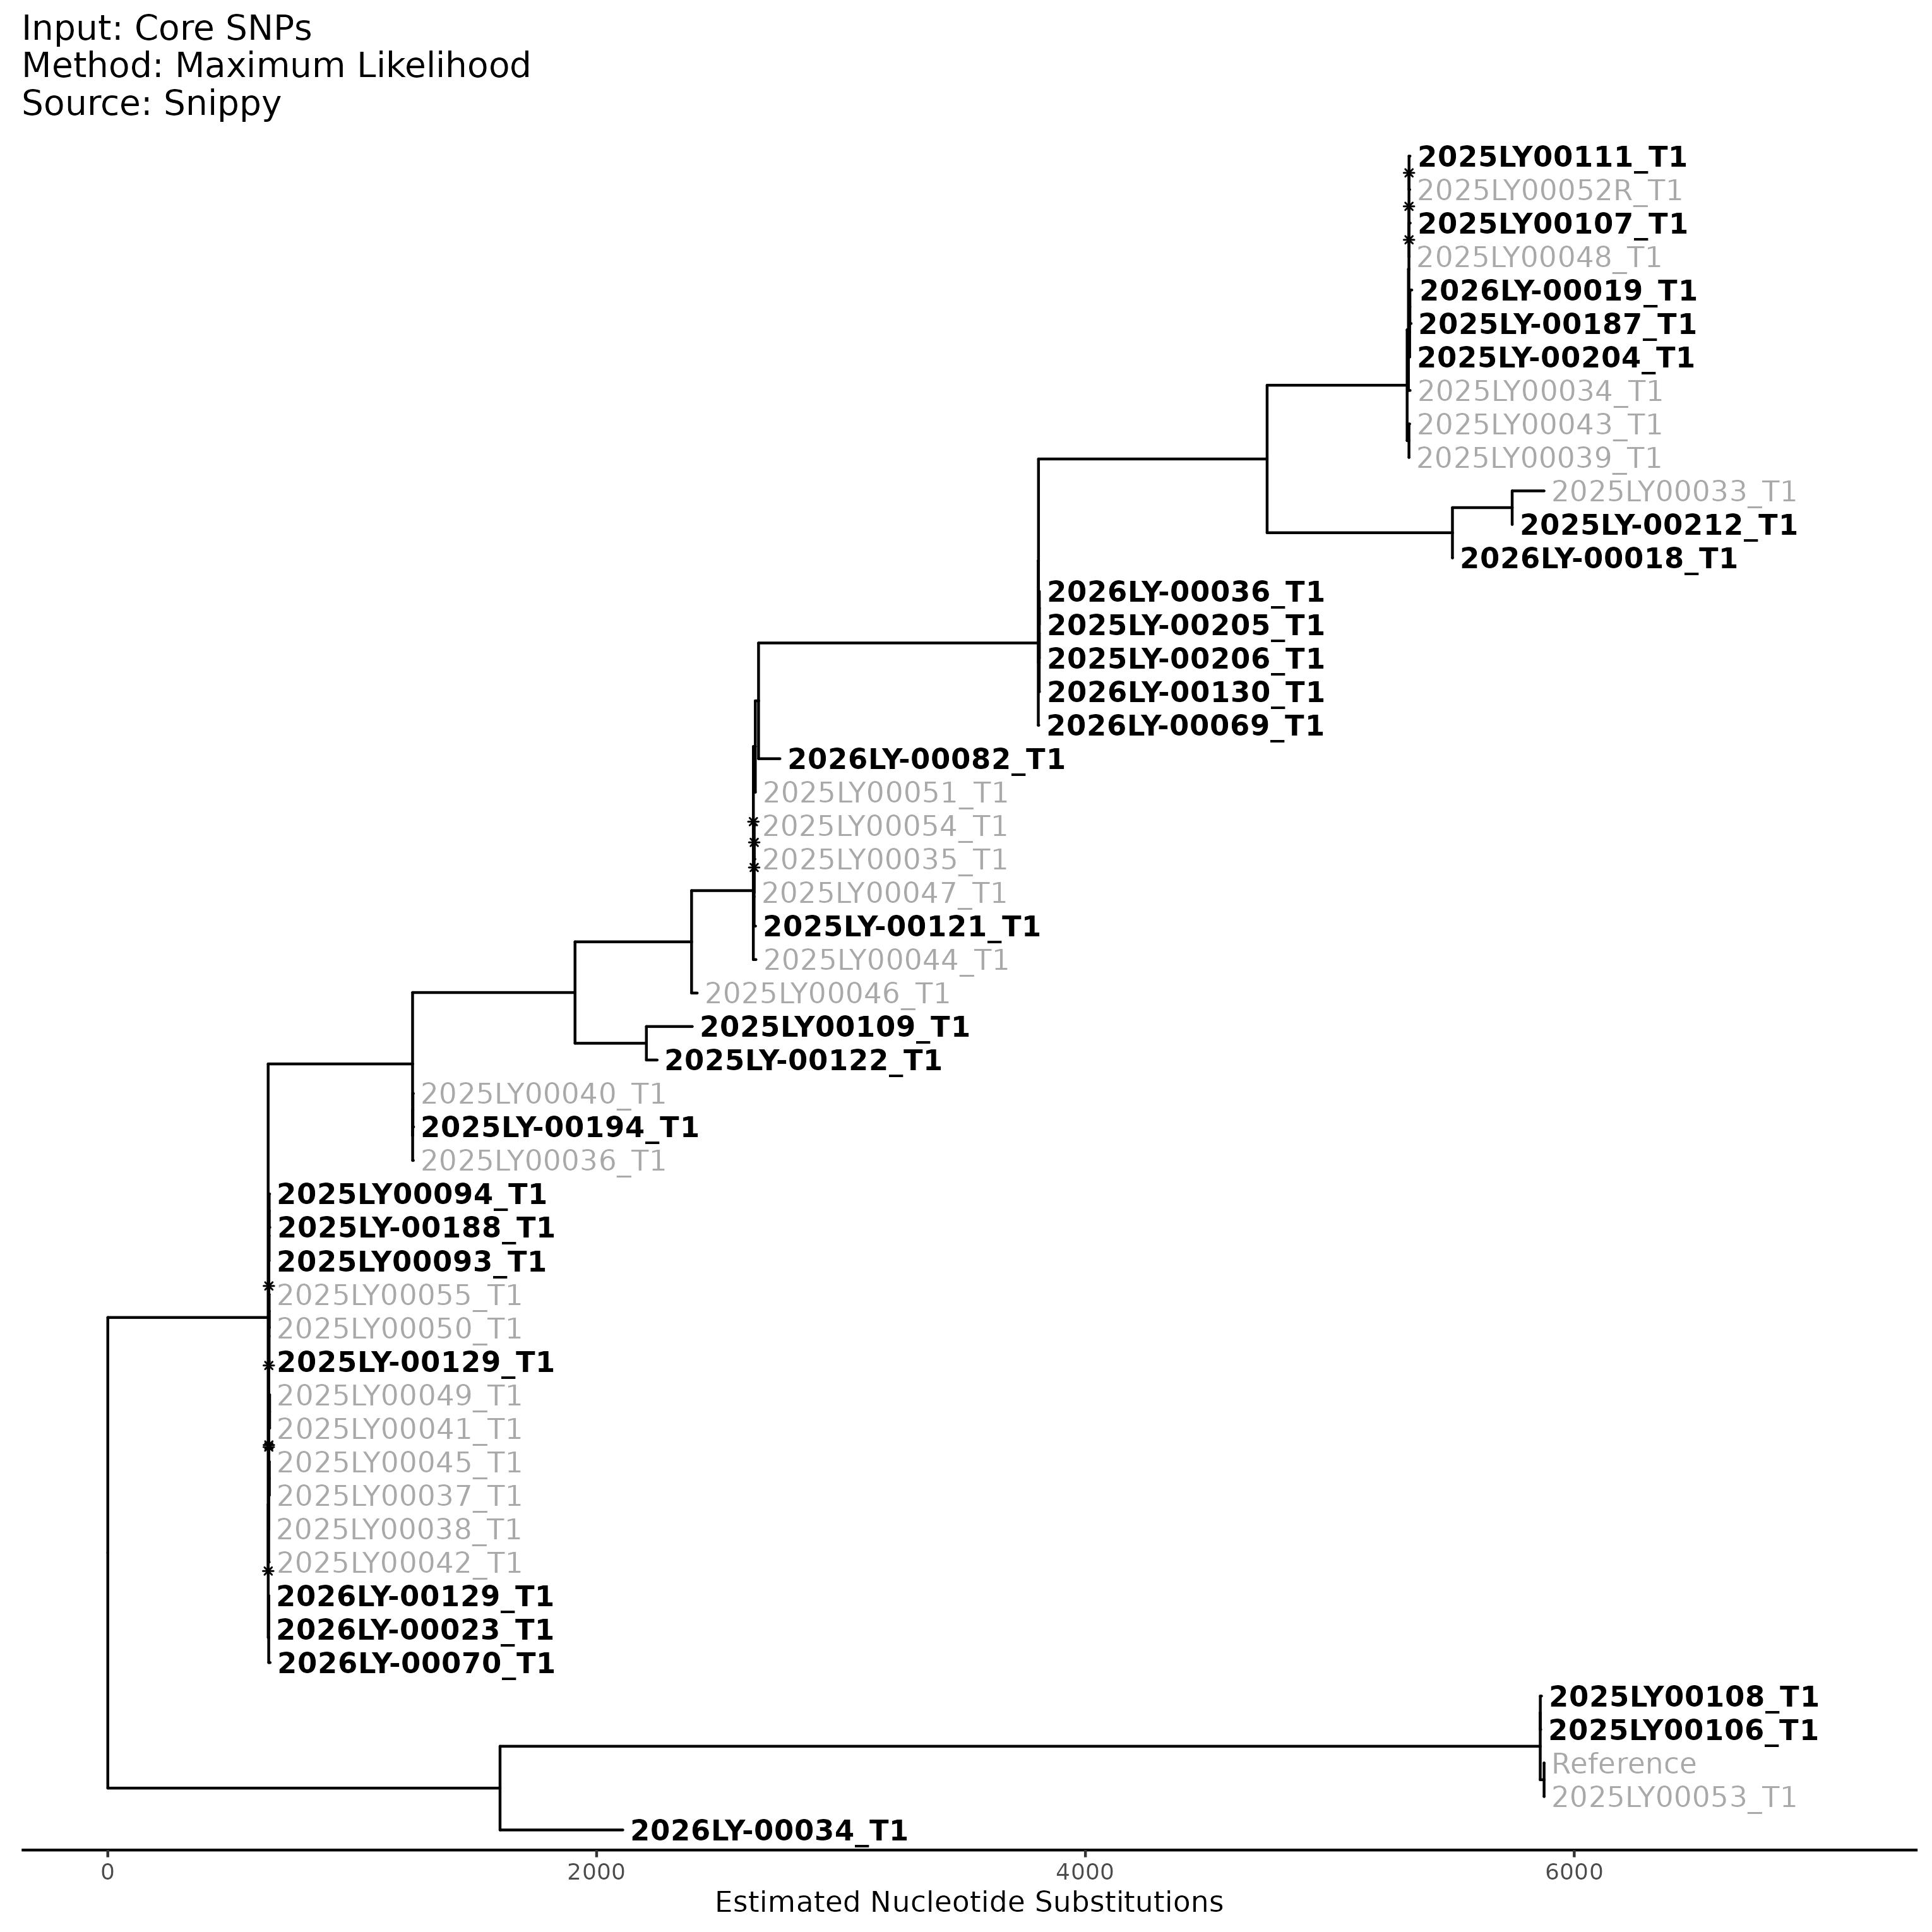
Secondary BigBacter Outputs
Maximum-likelihood phylogenetic tree:
*_core-snps_ML.snippy.jpg
Static image of the phylogenetic tree for a quick overview.
Shows relationships among isolates based on core-genome SNPs.

Slide 8
Secondary BigBacter Outputs (figure 2)
Core SNP distance matrix:
*_core-snps_dist.snippy.jpg
Shows pairwise core SNP distances between isolates.
Highlights groups of closely related isolates.
Notes:
For a detailed and interactive exploration, view the results in Microreact.
This gives us a quick static view of the pairwise SNP distances, but with this many isolates, the individual values become difficult to explore. That’s where Microreact becomes much more useful.

Slide 9
Questions
Practice modifying and running the code on your own time.
For additional information or questions, please contact:
tatyana.kiryutina@dph.ga.gov
Next section: Microreact
Dhondup Urg (Dhon), DPH Biostatistician and Epidemiologist at DPH

